Slide 1
Building a beer recommender
Camille Coeurjoly
Let’s go!

Slide 2
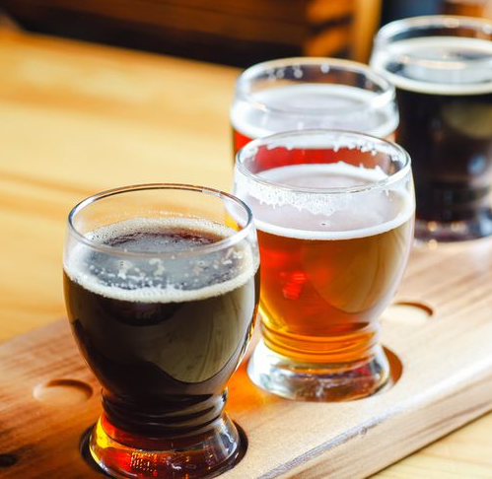
Agenda getting to a first mvp
Setting a Goal
Getting to know the Data
Creating a first Model
Building a first Recommender
It’s time for some Testing
What are the Next steps

Slide 3
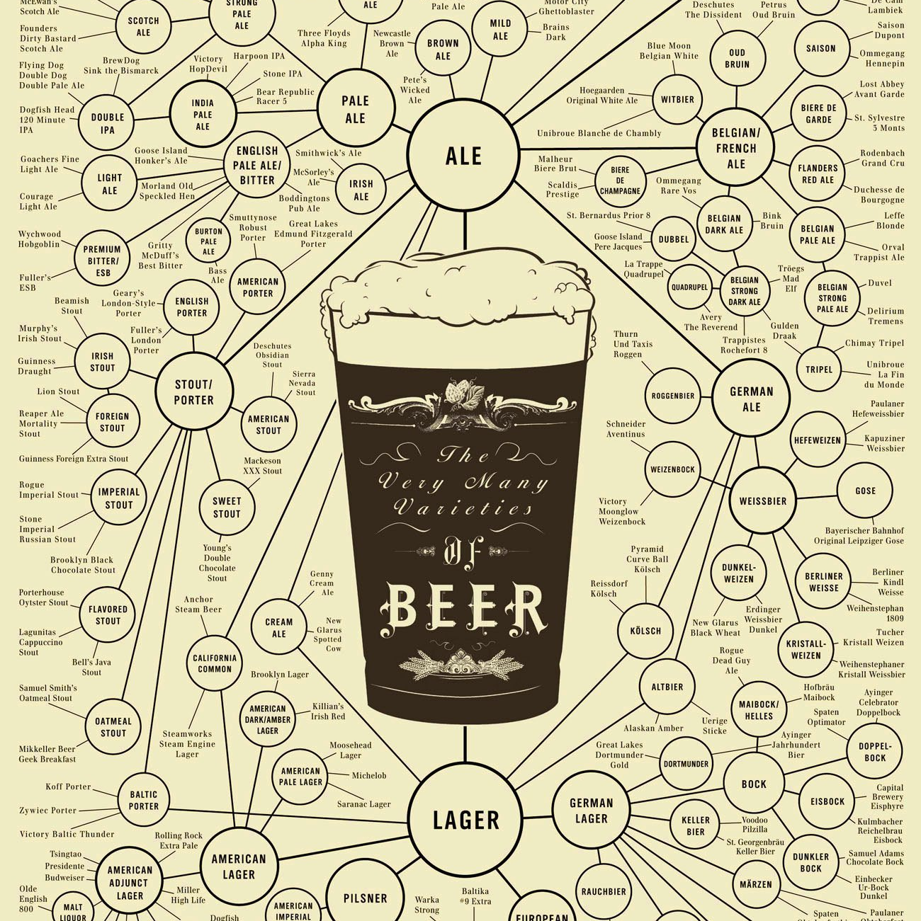
Goal 🎯
Why should we build a beer recommender?
What do we expect from a first MVP?
What do we want to learn from this project?

Slide 4
GETTING TO KNOW THE DATA
What are we working with and what can we use to make good recommendations?

Slide 5
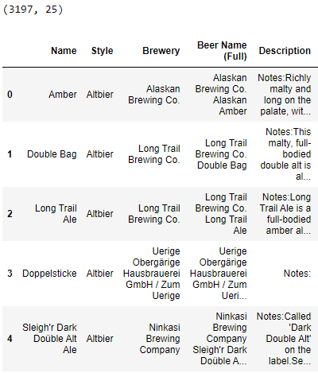
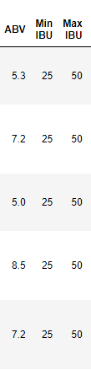
Features – Text, ABV and Bitterness
ABV: Alcohol by volume is used to measure the alcohol content of beer and other alcoholic drinks. They usually fall between 3.0 and 13.0 percent ABV.
IBU: International Bitterness Units, it’s a scale used to rate the bitterness level.
42% of the beers have an their description field left empty.

Slide 6
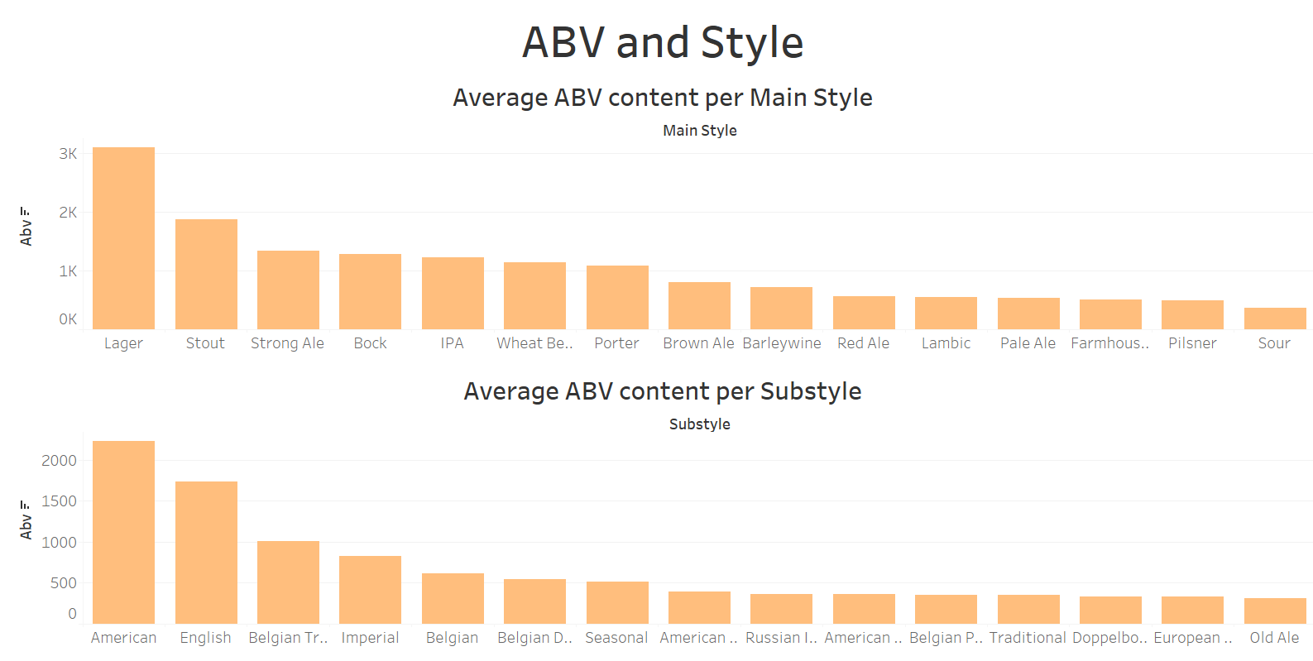
Features – ABV and Style

Slide 7
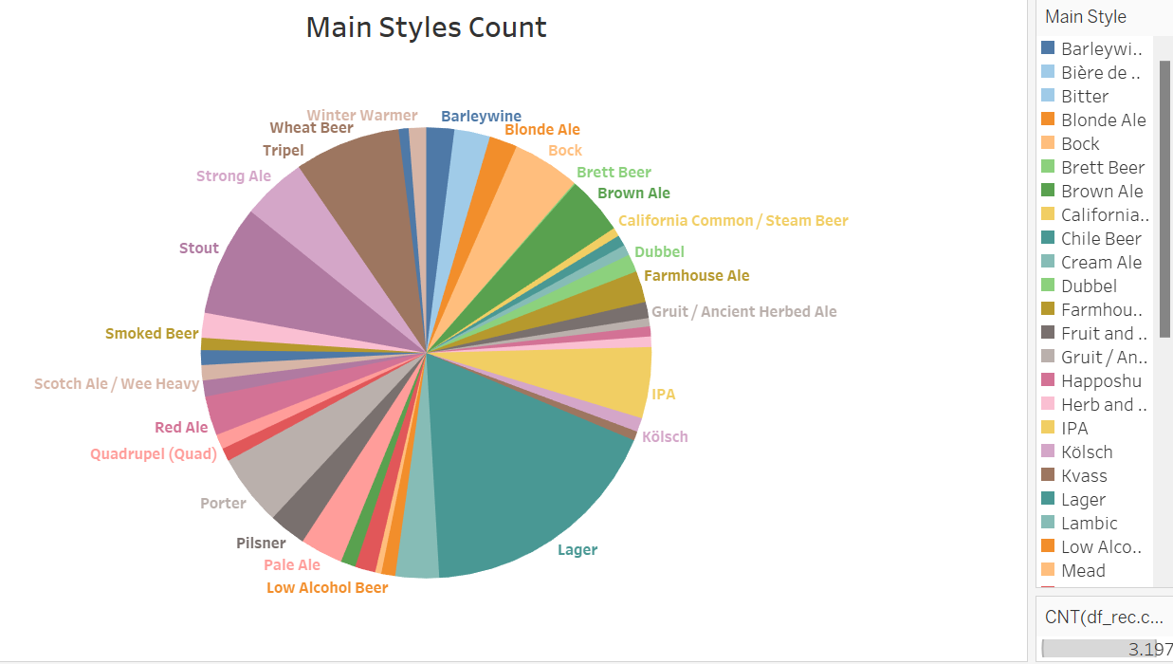
Features – Main Style

Slide 8
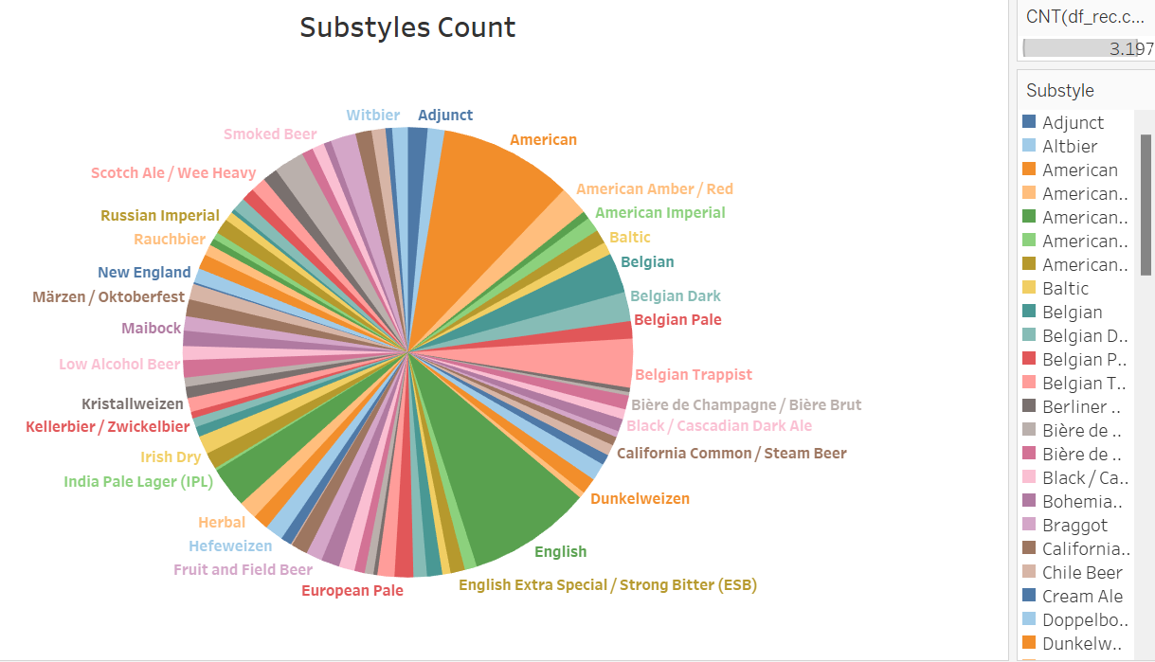
Features – Substyle

Slide 9
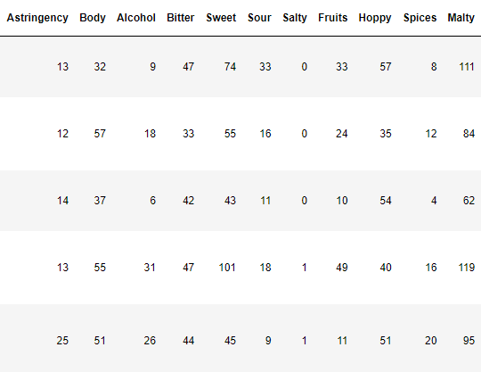
Features – Beer profile
Astringency: Not quite a taste so much as a physical sensation, hard to define. Too much Astringency is considered a flavor fault in beer. Good analogy: is like the dryness produced by a strong tea.
Body: Fullness of the flavor and mouthfeel, from watery to satiating (Ales, Stouts and Porters).
Alcohol: Impacts the body and bitterness.
Bitter: Due to the amount and type of hops used (IPA, IPL, APA)
Sweet: Strong malt presence and little hops.
Sour: Lactobacillus and Pediococcus, bacteria consuming food and producing acid as a by-product.
Salty: Salt is added as a taste enhancer.
Fruits: Fruitiness can either be added or be a result of hops, some strains of yeast or malts used.
Hoppy: Solid Malt base but Hops dominate. Counterbalance the sweetness.
Spices: Imparted by the yeast, especially when yeast is aged for several years.
Malty: Malts dominate, usually sweet.
Notes:
Hoppy: From a flavor standpoint, hops can help to temper the sweetness of the malt in beer. It also helps beer last longer without spoiling, which was particularly important before refrigeration was available. When you increase the hops in a recipe to extreme levels, though, you end up with something that can survive the trip from Great Britain to India by sea – and that’s why India Pale ale exists.
Fruity: Aged in a wine cask.
Spices: Lambic beers are using wild yeast.

Slide 10
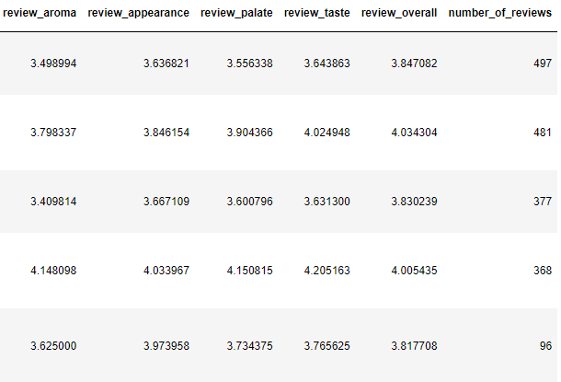
Features – Reviews
Average number of reviews is 233
Average overall review is 3.74

Slide 11
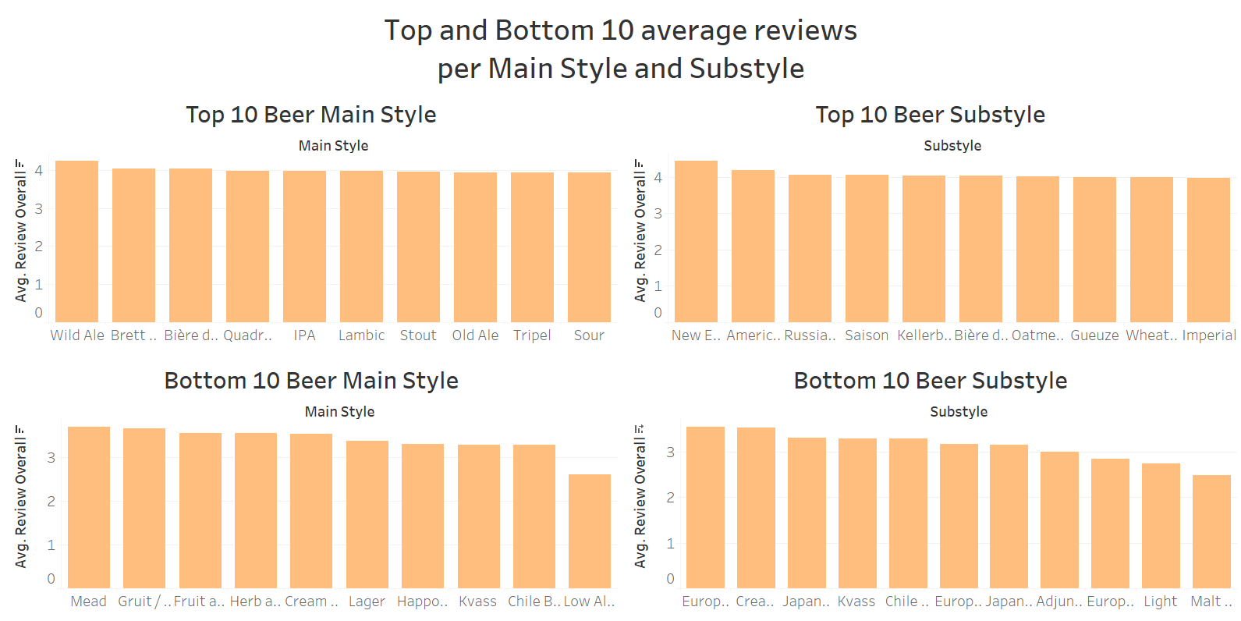
Features – Average Reviews

Slide 12
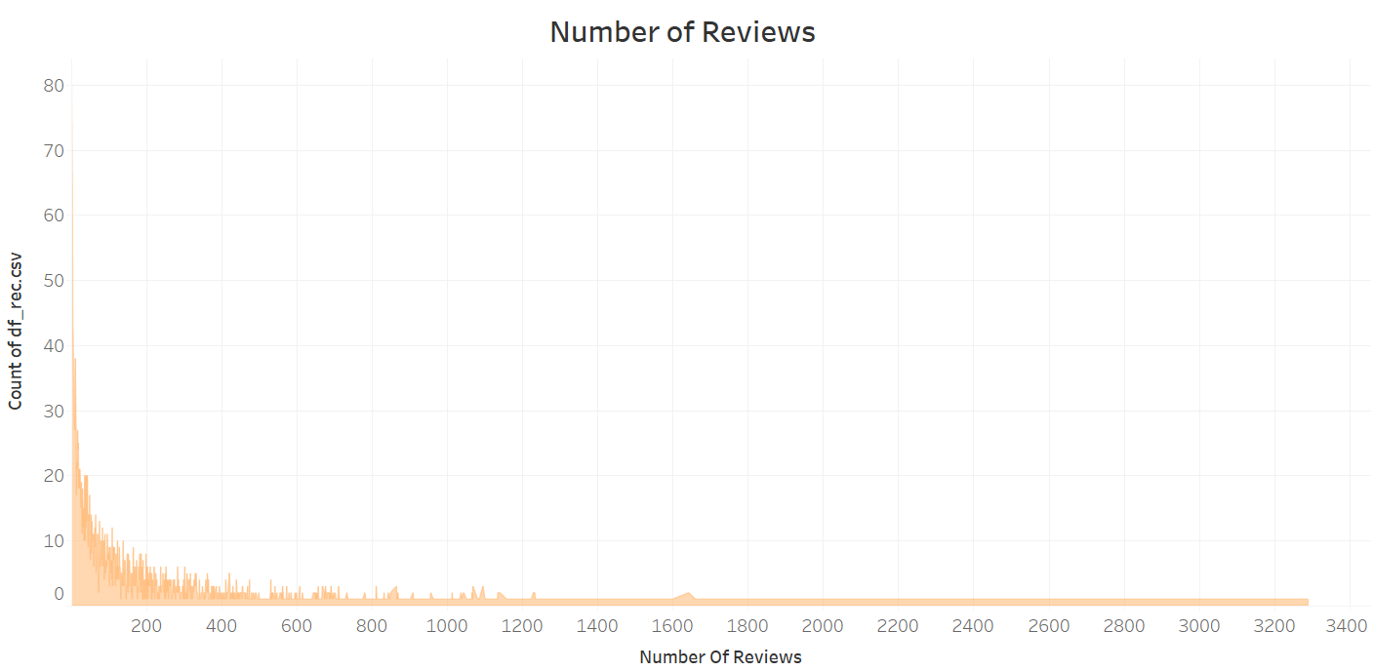
Features – Number of Reviews

Slide 13
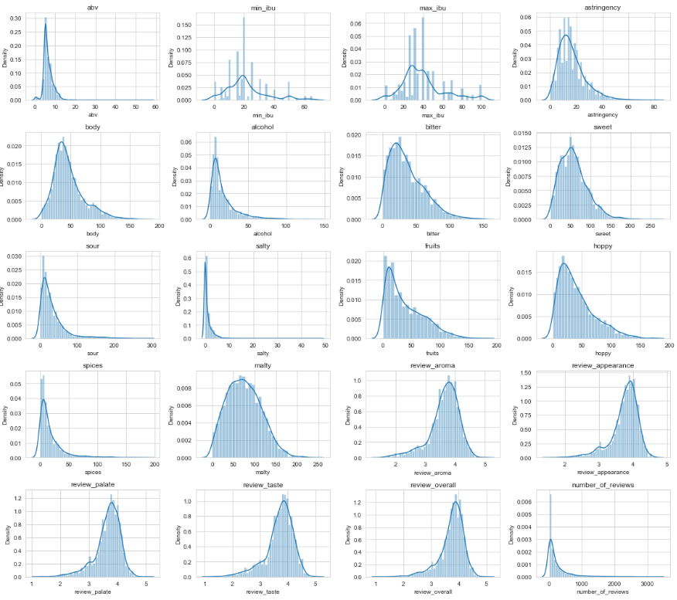
Numerical distributions
Most beer are not very salty.
The number of reviews skews towards 0.
The review features have very similar distributions.

Slide 14
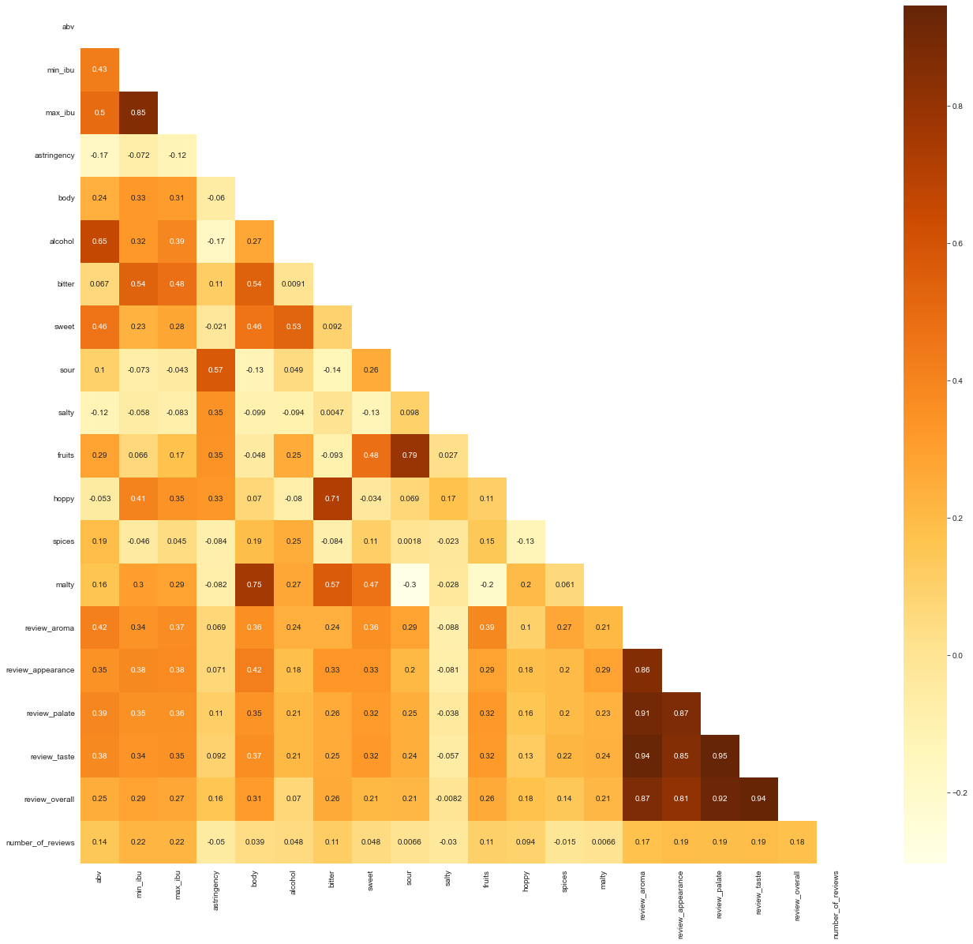
Correlations
High correlations between:
Body & Malty
Bitter & Hoppy
Sour & Fruits
Alcohol & ABV
Min and Max IBU
All of the review features
Notes:
`alcohol`, `max_ibu`, `min_ibu`, `sweet` and `review_aroma` have the strongest correlations with `abv`.

Slide 15
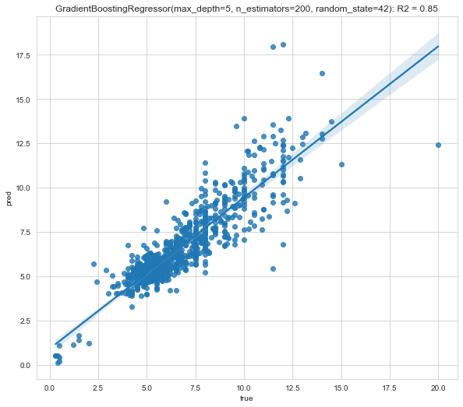
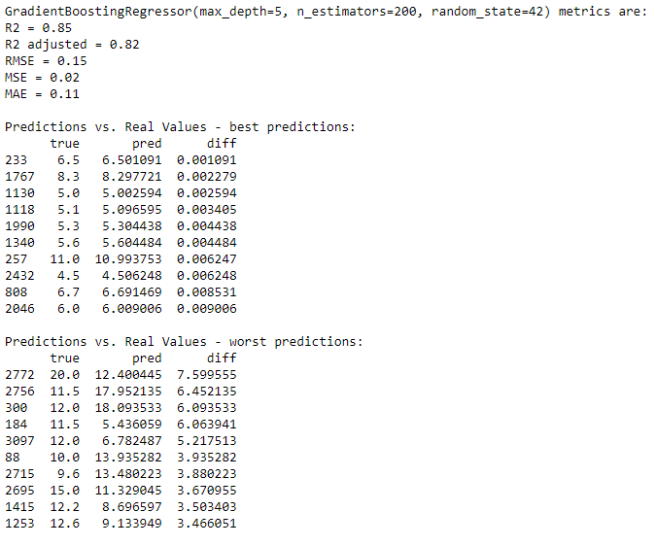
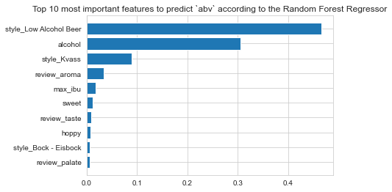
Predicting ABV

Slide 16
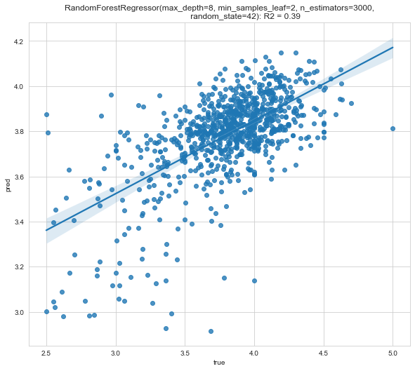
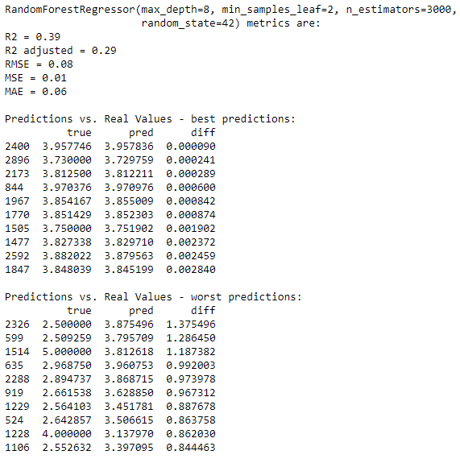
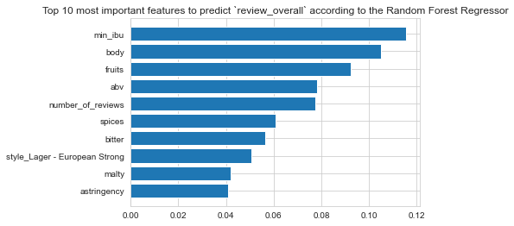
Predicting Review Overall

Slide 17
Creating a first model
Which model should the first recommender use and which features will the model be working with?

Slide 18
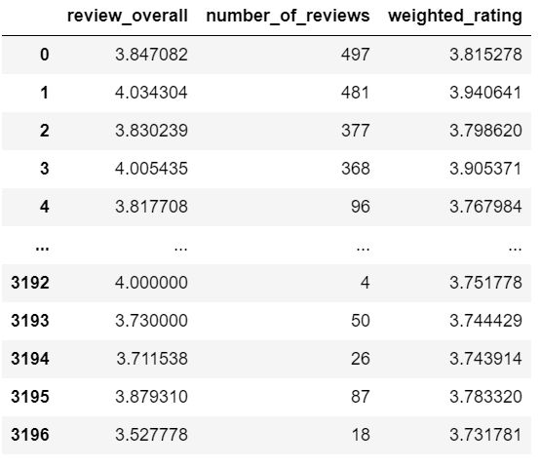
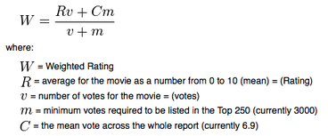
What features do we want the model to work with?
Weighted Rating
We want to be able to rank the beers with the highest overall review while taking into account the number of reviews.
To do this we used the formula currently used by IMDB.

Slide 19
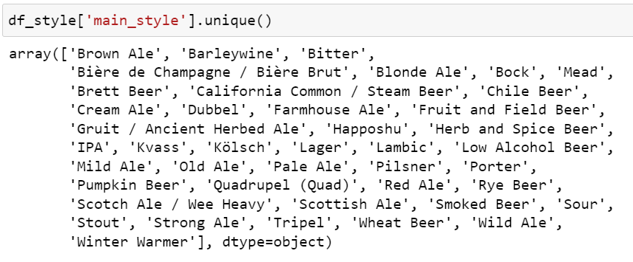
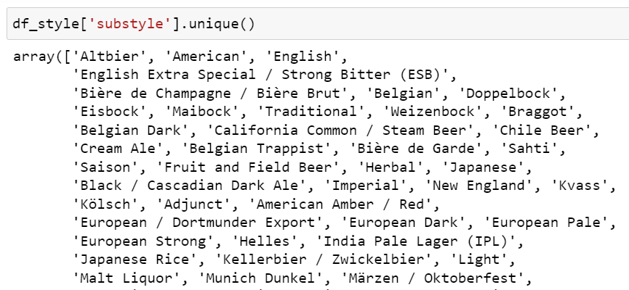
What features do we want the model to work with?
Creating two new Style columns: Main Style and Substyle
This column will be the most useful to process the user inputs when building the recommender, so it will be useful to parse the Style column that contains a lot of information.
This will allow us to group data that have attributes in common that were previously ‘invisible’ as more data in one column increased specificity.

Slide 20
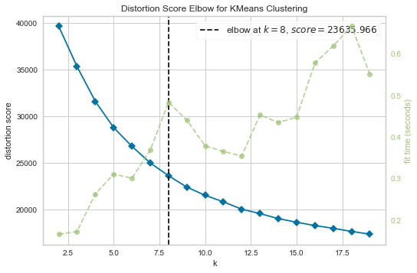
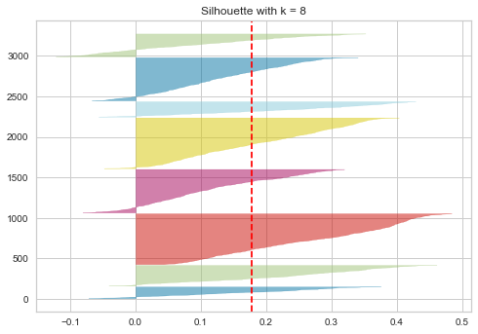
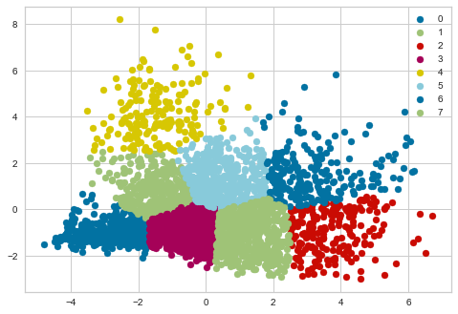
Clustering with KMeans
The model retained was the one using the Main Style rather than the original Style.
The review features were not included in the end as we wanted to have a clustering model working with the intrinsic characteristics of the beers.
The optimal number of clusters was determined to be 8.
Notes:
Why use Kmeans? It’s relatively simple, can be scaled to large datasets and easily adapts to new examples. It can also generalize clusters to different shape and sizes.

Slide 21
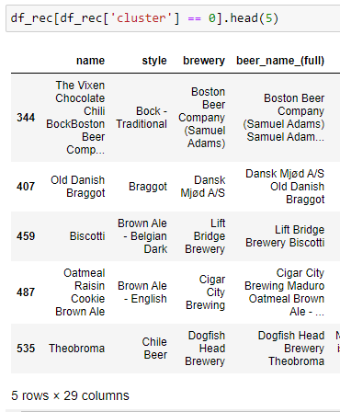
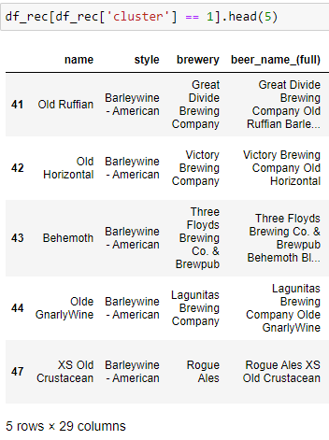
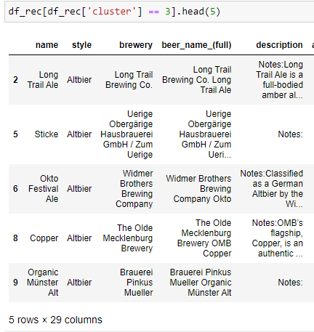
Let’s have a look at some clusters
Cluster 0
Cluster 1
Cluster 3

Slide 22
Building a beer recommender
Which questions should we ask ourselves and what would a user want from the product?

Slide 23
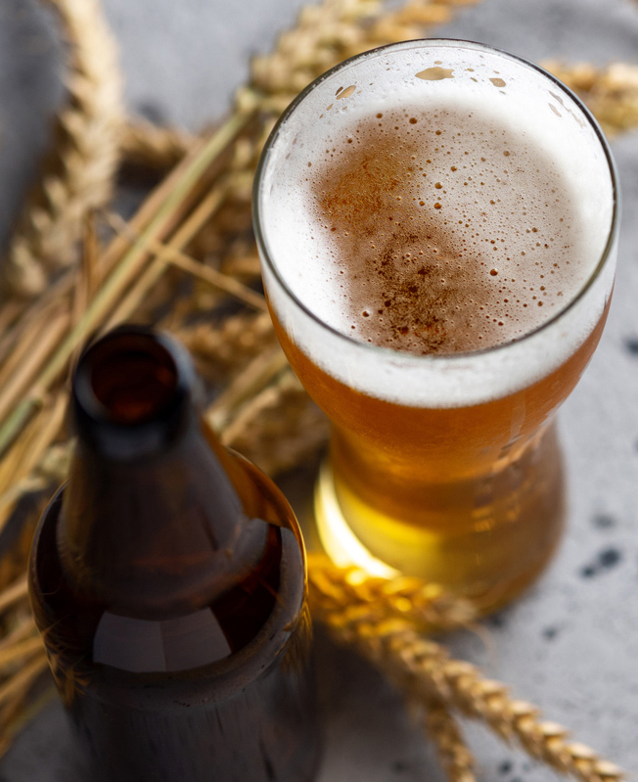
What can we use to make good recommendations?
Main Style
Substyle
Style
Name
Clusters
Nearest Neighbors
Weighted Rating
Notes:
Possible user inputs: a type, a beer name, a brewery name, a country
What will be the hierarchy used when processing the input? Where do we look first to find the information?

Slide 24
Architecture of the recommender
Asking the User for Input and Processing the Input
Counting the number of words in the input.
Formatting the input with some pre-defined functions.
Understanding the Input
Using a While Loop that will run until the recommender understands the input.
If not, it will ask the user to ask again.
Filtering the Data
Filtering the data based on the nature of the input.
If there is more than one input/filter, filtering based on 2 subsets of the data frame.
Finding the best recommendation
Recommending based on a beer style
OR
Recommending based on a beer or brewery name.
Giving the recommendations
Giving a list of 5 recommendations ranked by the weighted rating.

Slide 25
Now it’s time for testing
How do we break it?

Slide 26
Testing -> Bugs -> Solutions -> Improved MVP
Checking Hierarchy
Word order of the input
Number of input/filter found
If the words in the input existed in a beer Name the recommender favored that information over whether or not the input belonged to a beer Style.
Solution: changing the hierarchy.
If the word order of the input wasn’t exactly the same as in the data, the recommender couldn’t find the information.
Solution: additional input processing step that looks for all the word permutations was added.
The recommender gleaning not one but two filters from the input wasn’t accounted for at first.
Solution: adding an extra check to account for that possibility.

Slide 27
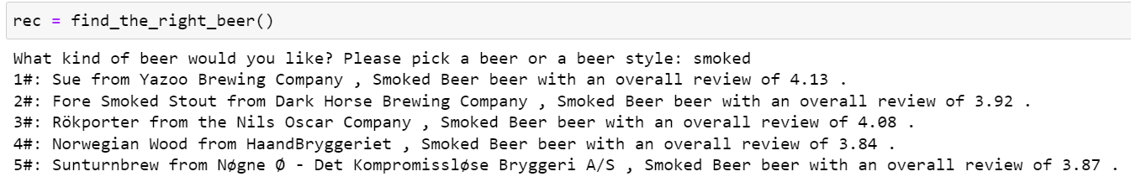
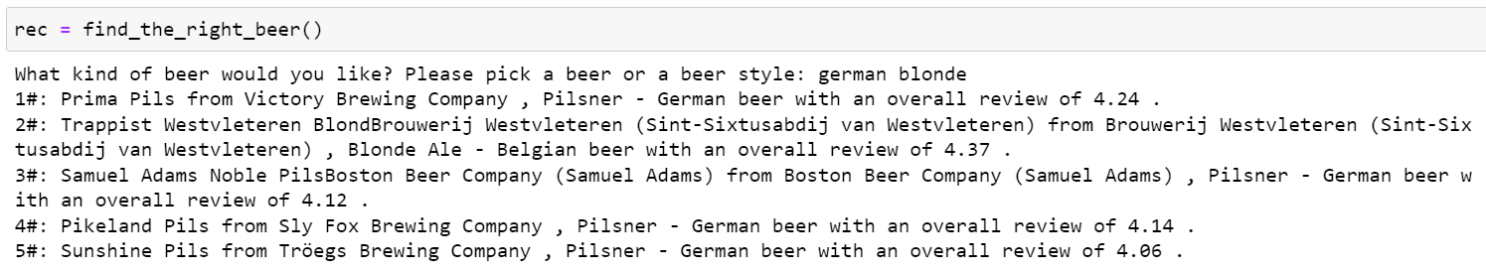
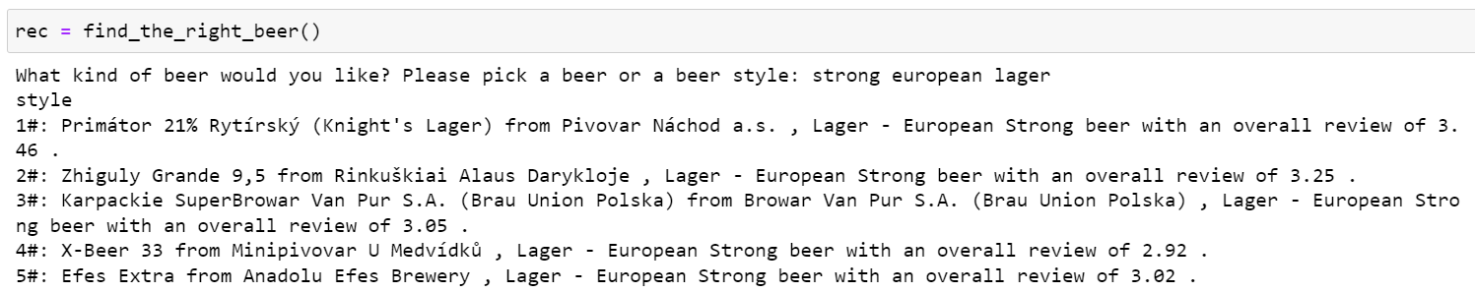
Magic recommender in the Python, who’s the tastiest one of all?
From top to bottom the inputs are recognized in Main Style, both Substyle and Main Style, and Style.

Slide 28
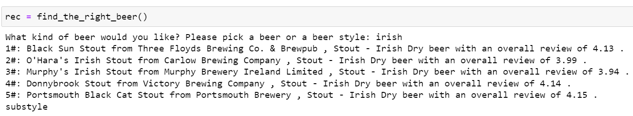
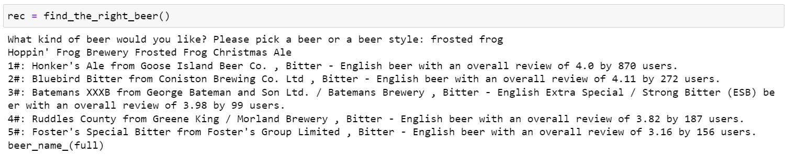
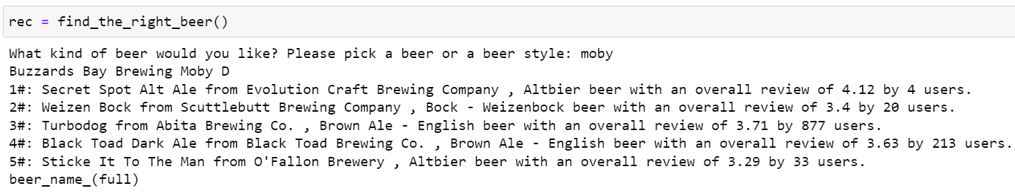
From top to bottom the inputs are recognized in Substyle and beer Name.

Slide 29
What are the next steps
Where do we go from there?

Slide 30
Future work
More data
Name Title
Name Title
Name Title
Notes:
More Data: Geographic, Location (origin or created?), access to more beer profiles, clustering with more data, + possibility to use profile as input, explore Brewery characteristics (name, type, size).

Slide 31
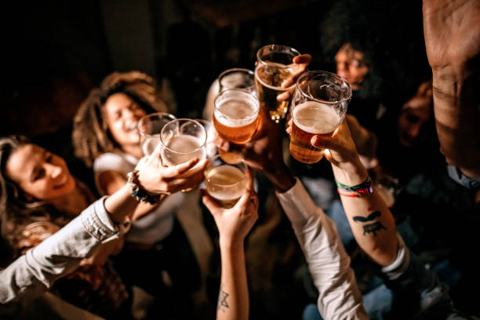
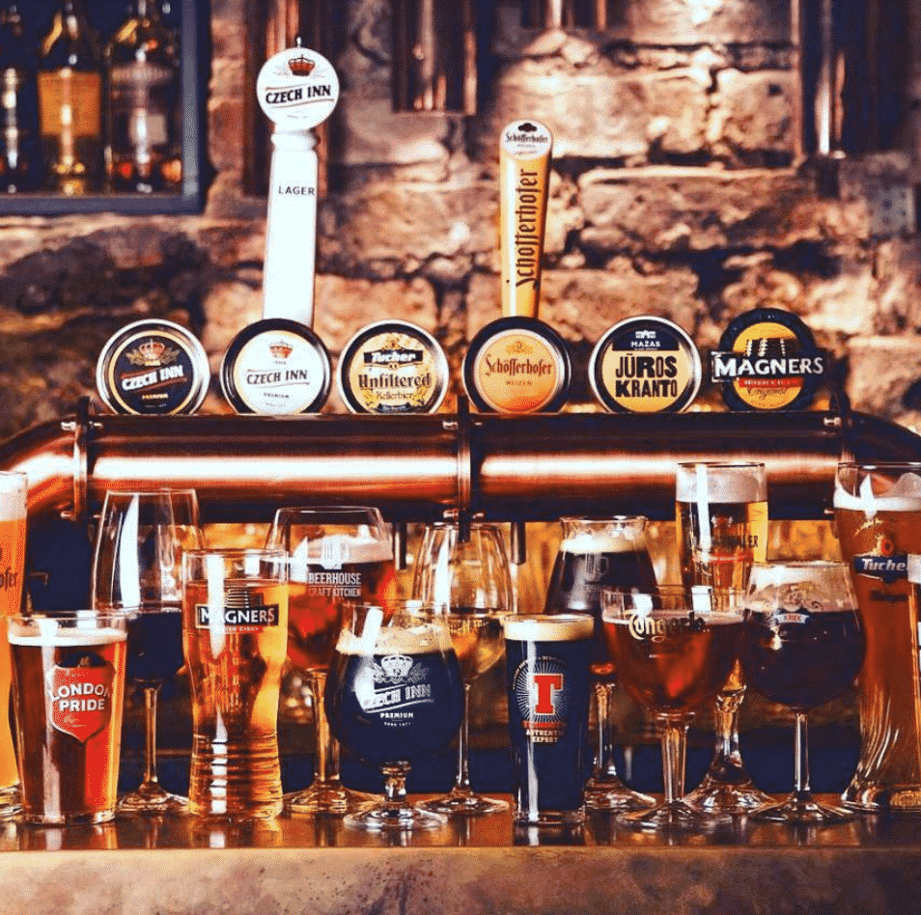
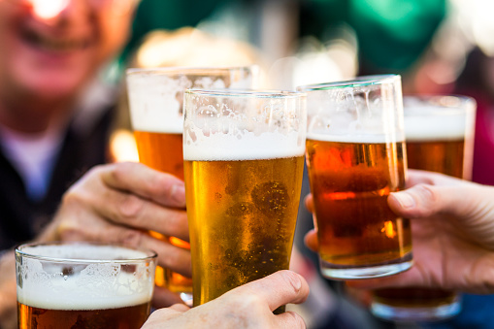
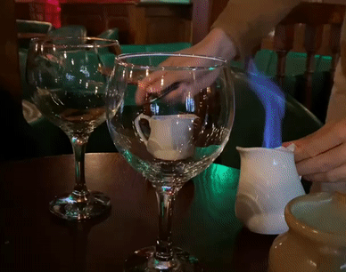
Thank you
Camille Coeurjoly

Slide 32
Link to dataset
https://www.kaggle.com/datasets/ruthgn/beer-profile-and-ratings-data-set

